Slide 1
DATA MINING AND BIG DATA ANALYTICS PROJECT
Smart Campus Analytics
A Data-Driven Approach to Student Experience & Engagement
Student Name: Lavanya E, Dechamma KP, Bhoomika YD, L Prajwal, Shashank Rao, Ganesh A
Program & Semester: MCA(Data Science), 3rd Sem
Guided by: Nagasri P
Smart Campus Analytics
1 / 16

Slide 2
Agenda
1
Introduction
6
Workflow
2
Problem Statement
7
Technology Used
3
About the Data
8
Implementation
4
Methodology
9
Results
5
Architecture
10
Discussion & Future Scope
Smart Campus Analytics
2 / 16

Slide 3
🎓
01 · INTRODUCTION
Background
Universities provide many facilities that influence student satisfaction and engagement.
Students have different experiences with classrooms, faculty, Wi-Fi, cafeteria, library, clubs, safety and transportation.
Traditional feedback makes it difficult to identify common problems and important factors.
Data Mining helps discover patterns and group students based on their experiences.
K-Means identifies student satisfaction groups, while Decision Tree identifies important satisfaction factors.
A Student Happiness Index (0–100) and interactive dashboard provide clear insights.
The results help the university identify priority areas and plan improvements.
Smart Campus Analytics
3 / 16

Slide 4
Scope
1
Survey Data
2
Unsupervised Learning
145 student responses covering 11 campus facility dimensions, collected through Google Forms. Includes responses from different academic departments and satisfaction ratings from 1–5.
K-Means Clustering is used to group students with similar satisfaction patterns. The groups are interpreted as Low, Moderate, and High Satisfaction.
3
Supervised Learning
4
Interactive Delivery
A Decision Tree classifier predicts Satisfied / Not Satisfied students. Feature importance identifies the key factors influencing the classification.
A Gradio dashboard presents KPIs, graphs, clusters, model results, and action plans. Students can also enter their ratings to view their Happiness Index and satisfaction status.
Smart Campus Analytics
4 / 16

Slide 5
02 · PROBLEM STATEMENT
Existing Problem
1. 📋 Buried in Spreadsheets : Survey data is stored in spreadsheets, making it difficult to understand and analyze.
2. ⏳ Slow Manual Review : Manually reviewing 145+ responses across 11 facility dimensions takes a lot of time and may give inconsistent results.
3. 👥 No Student Segmentation : Students cannot be easily grouped into Low, Moderate, and High Satisfaction categories.
4. 📊 Limited Visualization : Raw survey data does not provide an easy interactive view of satisfaction, trends, clusters, and major concerns.
5. 💡 Difficult to Prioritize Improvements Without proper analysis, administrators may not know which facilities need improvement first.
Universities gather feedback but rarely act on it systematically
Smart Campus Analytics
5 / 16

Slide 6
Objectives
✓
Quantify a single Happiness Index (0-100) per student from 11 facility ratings
✓
Group students into meaningful satisfaction clusters using K-Means
✓
Classify students as Satisfied / Not Satisfied and rank which facilities drive that outcome
✓
Deliver an interactive dashboard so staff can filter results by department
✓
Give students a self-check tool with a personalized recommendation
Smart Campus Analytics
6 / 16

Slide 7
03 · ABOUT THE DATA
Google Forms Survey Dataset
FACTORS ANALYZED
145
11
18
11
6
Classrooms
Faculty Interaction
1
2
Student Responses
Survey Questions
Rated Facility Dimensions
Programs Covered
Wi-Fi
Cafeteria
3
4
Library
Sports
Collection & Cleaning
5
6
Responses gathered live via a Google Form, exported to Excel
Fully empty rows / columns dropped; duplicate submissions removed
Column headers stripped of whitespace for consistent matching
11 satisfaction questions mapped to short facility labels (Wi-Fi, Library, Safety…)
Missing numeric ratings imputed with the column median
Clubs
Technical Events
7
8
7 / 16
Cleanliness
Safety
9
10
Transportation
11
Smart Campus Analytics

Slide 8
Google Forms Survey Dataset
Which program/department are you currently studying? | Which semester are you currently studying? | How satisfied are you with the quality and availability of classroom facilities? | How satisfied are you with faculty interaction, guidance, and support? | How satisfied are you with the availability and quality of campus Wi-Fi? | How satisfied are you with cafeteria food, cleanliness, and service? | How satisfied are you with library facilities, resources, and study environment? | How satisfied are you with sports facilities and opportunities? | How satisfied are you with student clubs and extracurricular activities? | How satisfied are you with technical events, workshops, seminars, and hackathons? | How satisfied are you with campus cleanliness and maintenance?
MCA | Semester 3 | 5 | 5 | 5 | 5 | 5 | 5 | 5 | 5 | 5
MCA | Semester 3 | 3 | 3 | 4 | 4 | 4 | 4 | 4 | 4 | 4
MCA | Semester 3 | 3 | 4 | 2 | 3 | 2 | 1 | 1 | 2 | 3
MCA | Semester 3 | 3 | 4 | 2 | 4 | 5 | 3 | 3 | 4 | 3
MSc | Semester 3 | 4 | 3 | 1 | 2 | 3 | 3 | 2 | 2 | 5
MCA | Semester 3 | 2 | 3 | 4 | 4 | 5 | 5 | 5 | 5 | 5
M.Tech | Semester 1 | 5 | 1 | 3 | 3 | 3 | 4 | 3 | 2 | 4

Slide 9
How satisfied are you with safety and security on campus? | How satisfied are you with university transportation facilities? | How actively do you participate in campus activities, clubs, events, or workshops? | Overall, how satisfied are you with your experience at the university? | Which areas need the most improvement? | What is one improvement you would like the university to make?
5 | 5 | 5 | 5 | Cafeteria | All good
4 | 4 | 1 | 3 | Classroom facilities | Everything Good
4 | 3 | 1 | 2 | Classroom facilities, Wi-Fi, Sports, Clubs, Cleanliness | Classroom facilities and wifi
5 | 5 | 1 | 4 | Classroom facilities, Faculty interaction, Wi-Fi, Cafeteria, Cleanliness, Transportation | Fixing the fans, internet and light
2 | 2 | 2 | 1 | Faculty interaction, Wi-Fi | Food
4 | 5 | 5 | 4 | Classroom facilities, Faculty interaction | Nothing
4 | 2 | 2 | 4 | Wi-Fi, Library, Clubs, Technical events, Safety, Transportation | Placements
Google Form Link of Survey

Slide 10
04 · METHODOLOGY
From Raw Survey to Insight
1
2
3
4
Data Collection
Preprocessing
Modeling
Evaluation
➜
➜
➜
145 responses gathered through a Google Form and exported as an Excel file.
Drop empty rows/cols, remove duplicates, map questions to facility labels, impute missing values.
Happiness Index calculated; K-Means clustering (k=3) and a Decision Tree classifier trained.
Cluster profiles reviewed; classifier accuracy and feature importance measured on a held-out test set.
Smart Campus Analytics
8 / 16

Slide 11
05 · SYSTEM ARCHITECTURE
Student
Survey
▶
Excel
Dataset
▶
Data
Cleaning
▶
Feature
Selection
▶
Exploratory
Data Analysis
▼
K-Means Clustering
Decision Tree Classification
Happiness Index
Student Groups
Satisfaction Prediction
0–100 Score
▼
Interactive Dashboard (Gradio)
▶
Insights & Action Plan
Smart Campus Analytics
9 / 16

Slide 12
06 · WORKFLOW
1
Problem Identification
7
Machine Learning
2
Define Scope
8
Visualization
3
Data Collection
9
Dashboard Development
4
Data Cleaning
10
Action Plan
5
Exploratory Data Analysis
11
Conclusion
6
Feature Selection
Problem → understand student experience gaps. Data Mining → apply K-Means and Decision Tree. Output → dashboard, insights and recommendations.
Smart Campus Analytics
10 / 16

Slide 13
07 · TECHNOLOGY USED
Tools & Libraries
1
2
3
4
Python
Google Colab
Excel
Pandas
Main programming language
Development environment
Data source
Data processing
5
6
7
8
NumPy
Scikit-learn
Plotly
Gradio
Numerical operations
Machine learning
Interactive visualization
Interactive dashboard
MACHINE LEARNING TECHNIQUES
K-Means Clustering • Decision Tree Classification • StandardScaler
Smart Campus Analytics
11 / 16

Slide 14
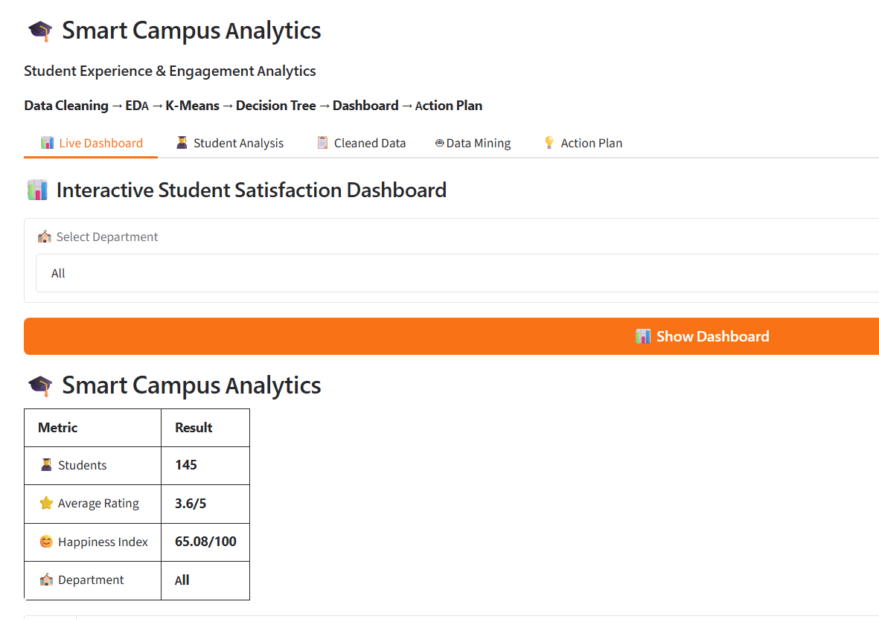
08 · IMPLEMENTATION
Live Dashboard Tab
📊
For Administrators
gr.Blocks()
Department filter (All / B.Tech / BCA / BSc / M.Tech / MCA / MSc)
Headline metrics: student count, average rating, happiness index
Horizontal bar chart of facility-by-facility satisfaction
Pie chart of Very Happy / Happy / Neutral / Needs Improvement
Auto-generated improvement suggestions per weak facility
Smart Campus Analytics
12 / 16

Slide 15
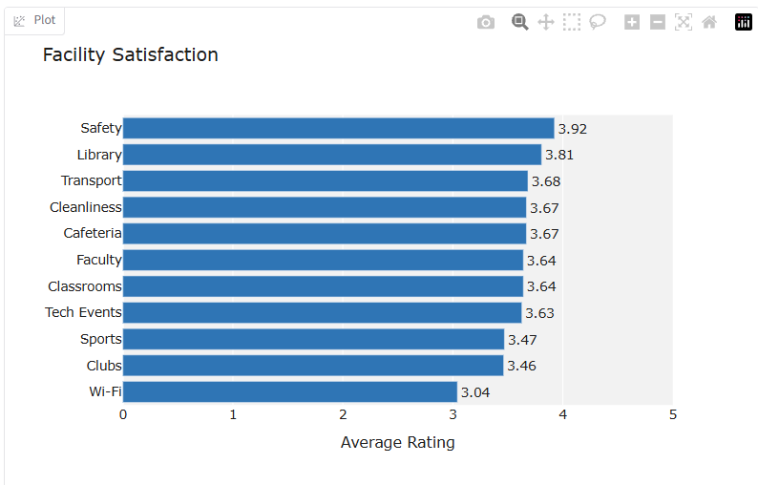
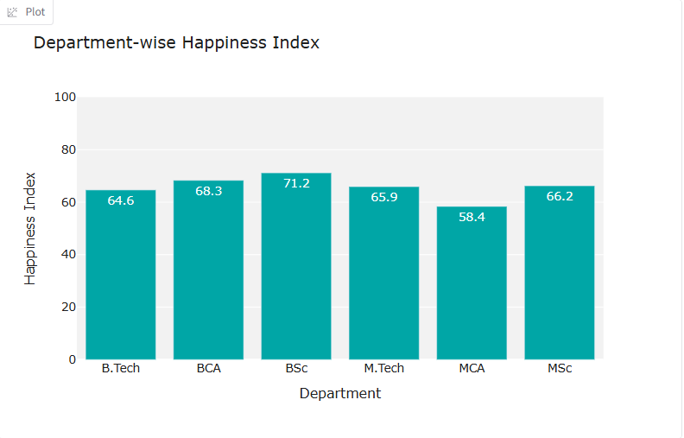
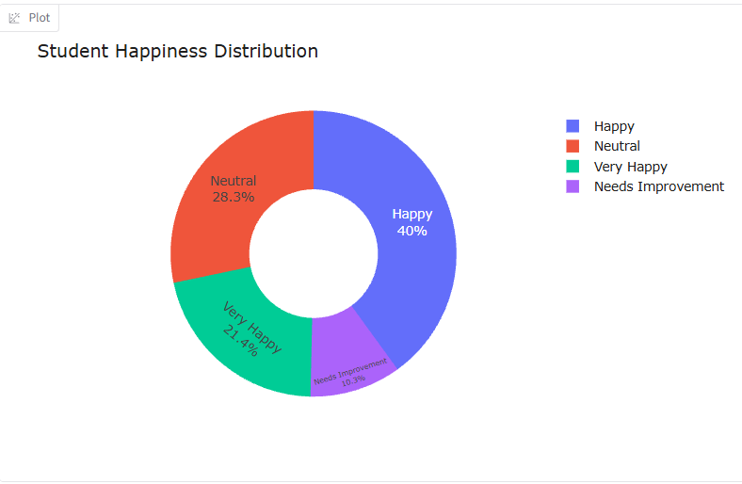
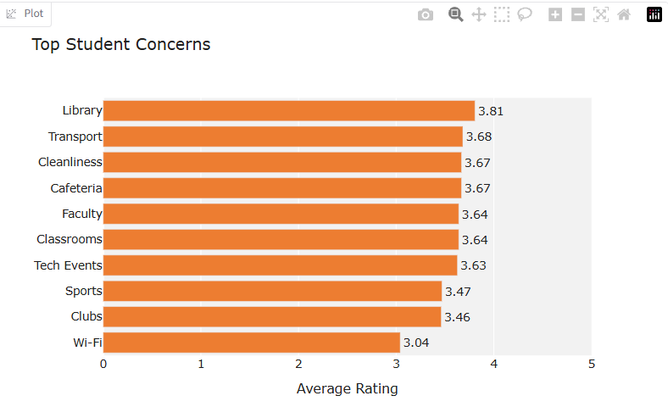

Slide 16
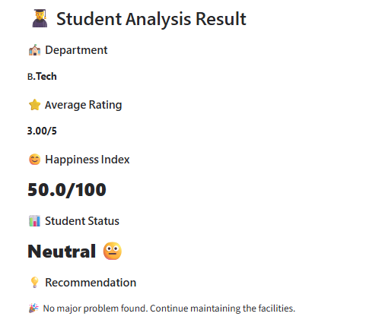
08 · IMPLEMENTATION
Student Analysis Tab
🎓
For Students
A student rates all 11 facilities on 1-5 sliders
App computes their personal Happiness score instantly
Status returned: Very Happy / Happy / Neutral / Needs Improvement
Any facility rated ≤ 2 is flagged as a low area
Targeted recommendation text generated automatically
Smart Campus Analytics
13 / 16

Slide 17
09 · RESULTS
Key Findings
Student Happiness Index – 65.1/100 The overall student experience is at a moderate satisfaction level.
Decision Tree Accuracy – 93.1% The model achieved 93.1% accuracy in classifying students as Satisfied or Not Satisfied.
Majority are Moderately Satisfied The largest group is Moderate Satisfaction (70 students), followed by High Satisfaction (59) and Low Satisfaction (16).
Clubs are the Strongest Decision-Tree Driver Clubs have the highest feature importance (49%), indicating they are the strongest predictor among the features used by the model.
Wi-Fi is a Major Improvement Area Wi-Fi has the lowest average facility rating (3.04/5), making it an important area for improvement.
Other Important Drivers The Decision Tree also identified Cafeteria (18%), Safety (10%), Library (9%), and Transport (8%) as important features.
Smart Campus Analytics
14 / 16

Slide 18
10 · DISCUSSION
What the Results Tell Us
1
Wi-Fi is the weakest facility overall
2
But Clubs drives the outcome most
Lowest average rating (3.04/5) — a broad, widely-felt pain point across nearly every department.
The Decision Tree ranks Clubs as by far the strongest predictor (49% importance) of whether a student is satisfied — bigger than Wi-Fi's effect.
3
A large "movable middle" exists
4
High classifier confidence
70 of 145 students fall in the Moderate Satisfaction cluster — the group most likely to shift with targeted improvements.
93.1% accuracy shows the 11 facility ratings capture most of what determines overall satisfaction.
Smart Campus Analytics
15 / 16

Slide 19
11 · FUTURE SCOPE
NLP Sentiment Analysis – Analyze students' written feedback and identify positive or negative sentiments.
Longitudinal Tracking – Collect feedback every semester to track changes in student satisfaction over time.
Real-Time Dashboard – Connect the dashboard to updated survey data for continuous monitoring.
Early-Alert System – Automatically identify low-satisfaction student groups that may need attention.
Department & Semester Analysis – Compare satisfaction across departments and semesters in greater detail.
Production Deployment – Deploy the system for actual university use with secure access and regularly updated data.
Github Link
https://github.com/Shashankrao412/data_mining_projects/tree/main/Final_project
Smart Campus Analytics
16 / 16

Slide 20
THANK YOU
Smart Campus Analytics
16 / 16

